Slide 1



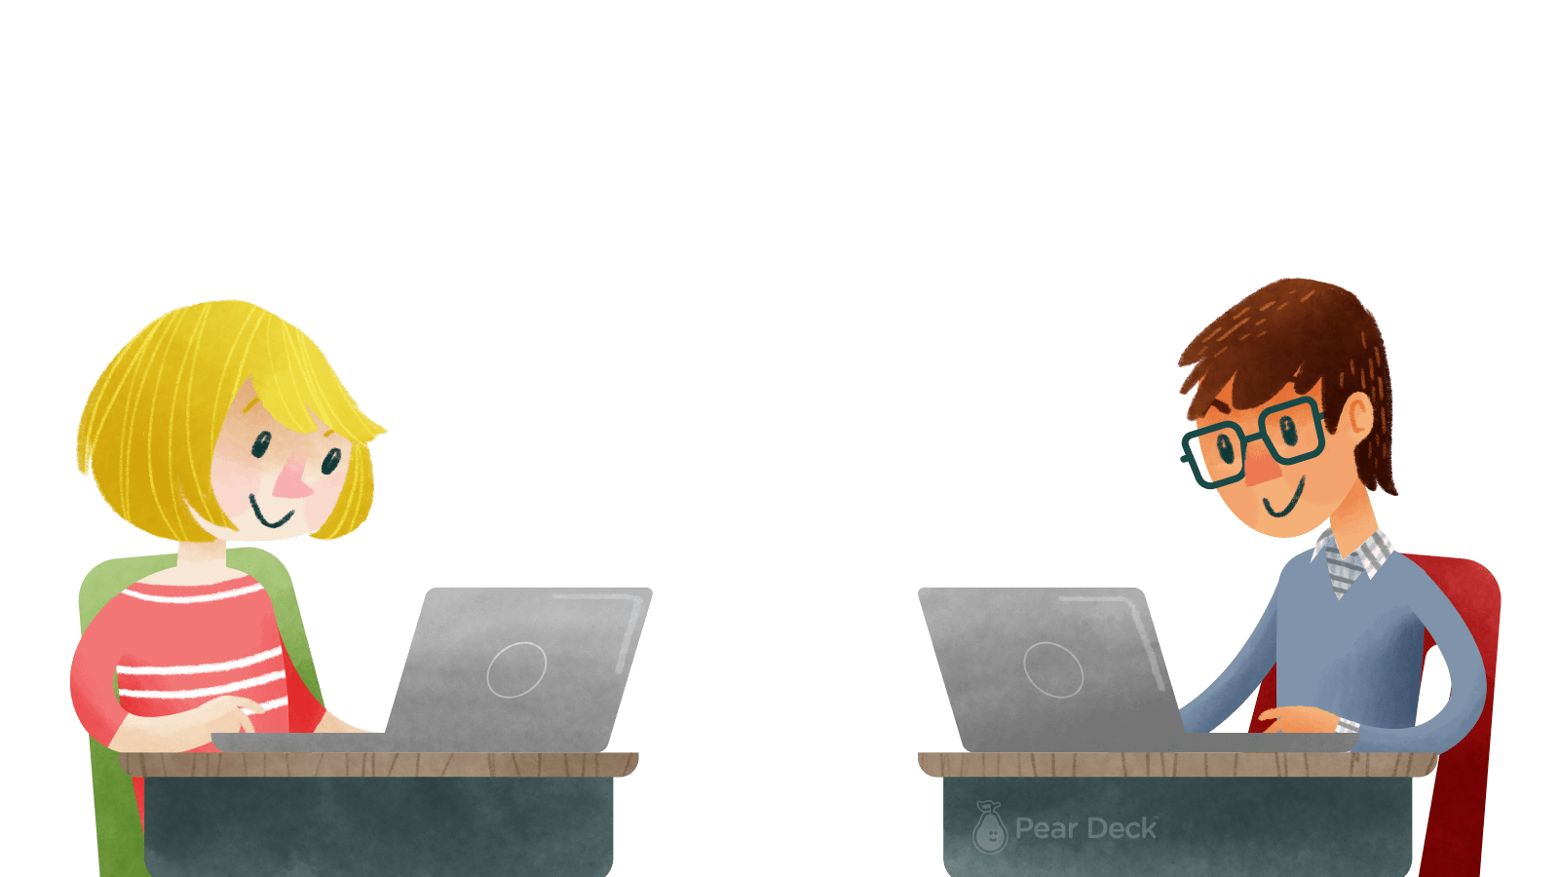
Welcome Back To Science Lab

Slide 2

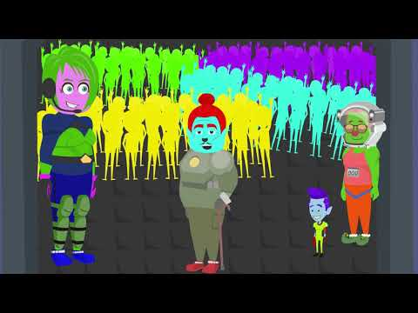
Engage
Watch
Cosmicon Academy Episode 1
Notes:
🍐 This is a Pear Deck Web Slide.
🍐 To edit the type of question, go back to the "Ask Students a Question" in the Pear Deck sidebar.
The following slides can be used in a self-paced lab report activity. When doing a lab experiment, toggle your Pear Deck presentation to “Student-Paced Mode” allowing students to advance through the report as they conduct the experiment. You can use as many of the slides as is appropriate for your class. You can even keep the Session “Live” and let student complete the report for homework.

Slide 3
Explore
This year we are going to journey along with Emelia as she goes on a wonderful adventure to discover the universe. Here on Earth we call this journey science.
Notes:
🍐 This is a Pear Deck Text Slide
🍐 To edit the type of question, go back to the "Ask Students a Question" in the Pear Deck sidebar.
The following slides can be used in a self-paced lab report activity. When doing a lab experiment, toggle your Pear Deck presentation to “Student-Paced Mode” allowing students to advance through the report as they conduct the experiment. You can use as many of the slides as is appropriate for your class. You can even keep the Session “Live” and let student complete the report for homework.

Slide 4



Drag your dot to indicate whether you agree or disagree:
Science is fun and important!
Agree
Disagree
Notes:
Agree or Disagree
Use this template to do a quick check of students’ opinions during your lesson.
🍐 This is a Pear Deck Draggable™ Slide.
🍐 To edit the type of question, go back to the "Ask Students a Question" in the Pear Deck sidebar.

Slide 5

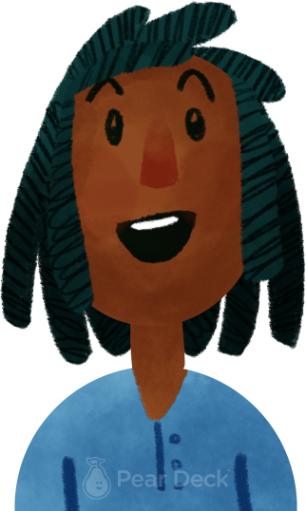
What do scientists do?
Notes:
Thinking Broadly
Identifying and articulating questions we have is an important thinking skill. Give students the opportunity to think broadly about today’s topic and identify their own questions. Show their responses anonymously on the projector to discuss.
🍐 This is a Pear Deck Text Slide
🍐 To edit the type of question, go back to the "Ask Students a Question" in the Pear Deck sidebar.

Slide 6
Explain
Scientist investigate the cosmos. I know that is probably a new word. Cosmos means the universe. That means scientists study space, planets, stars, the Earth and everything on the Earth.
Notes:
🍐 This is a Pear Deck Text Slide
🍐Scientist investigate the cosmos. I know that is probably a new word. Cosmos means the universe. That means scientists study space, planets, stars, the Earth and everything on the Earth. can use as many of the slides as is appropriate for your class. You can even keep the Session “Live” and let student complete the report for homework.

Slide 7
Explain
But how do they investigate the cosmos?
Notes:
🍐 This is a Pear Deck Multiple Choice Slide. Your current options are: A: Observation, B: Investigation, C: Experimentation, D: All of the above,
🍐 To edit the type of question or choices, go back to the "Ask Students a Question" in the Pear Deck sidebar.
The following slides can be used in a self-paced lab report activity. When doing a lab experiment, toggle your Pear Deck presentation to “Student-Paced Mode” allowing students to advance through the report as they conduct the experiment. You can use as many of the slides as is appropriate for your class. You can even keep the Session “Live” and let student complete the report for homework.

Slide 8
Explain
But how do they investigate the cosmos?
They make observations, perform investigations, and conduct experiments to learn more about the way things work.
Notes:
🍐 This is a Pear Deck Text Slide But how do they investigate the cosmos?
They make observations, perform investigations, and conduct experiments to learn more about the way things work.
🍐 To edit the type of question, go back to the "Ask Students a Question" in the Pear Deck sidebar.
The following slides can be used in a self-paced lab report activity. When doing a lab experiment, toggle your Pear Deck presentation to “Student-Paced Mode” allowing students to advance through the report as they conduct the experiment. You can use as many of the slides as is appropriate for your class. You can even keep the Session “Live” and let student complete the report for homework.

Slide 9
Start a Mind Map by drawing or typing anywhere: What do scientists use to help them study the cosmos?
Type or draw in white space
Scientist
Notes:
Mind Map
Starting with a central idea, give students time to branch out their thoughts visually to help build connections.
What do scientists use to help them study the cosmos?
🍐 This is a Pear Deck Drawing Slide
🍐 To edit the type of question, go back to the "Ask Students a Question" in the Pear Deck sidebar.

Slide 10
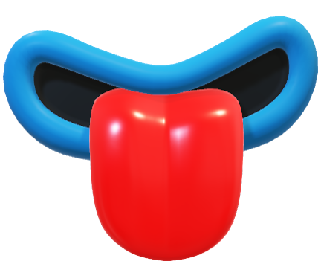
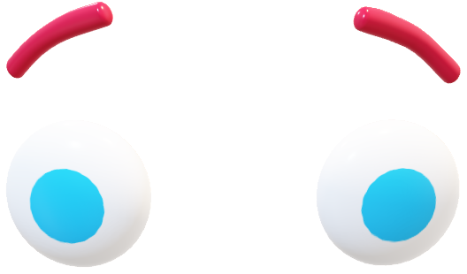

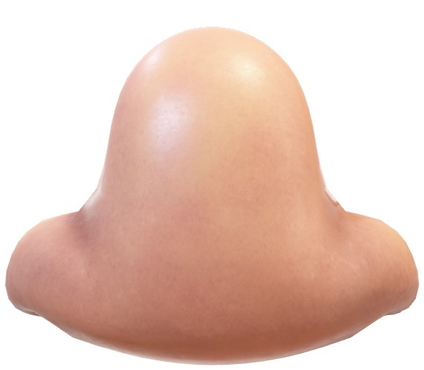
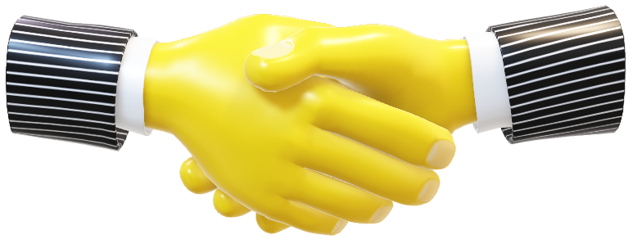
Explain
What do scientists use to help them study the cosmos?
Scientists use their senses: see, touch, smell, hear, and taste.
Also, with the help of SCIENCE TOOLS, scientist can learn just about almost anything.
Notes:
🍐 This is a Pear Deck Text Slide
What do scientists use to help them study the cosmos?
What do scientists use to help them study the cosmos?Scientists use their senses: see, touch, smell, hear, and taste. Also, with the help of SCIENCE TOOLS, scientist can learn just about almost anything.
🍐 To edit the type of question, go back to the "Ask Students a Question" in the Pear Deck sidebar.
The following slides can be used in a self-paced lab report activity. When doing a lab experiment, toggle your Pear Deck presentation to “Student-Paced Mode” allowing students to advance through the report as they conduct the experiment. You can use as many of the slides as is appropriate for your class. You can even keep the Session “Live” and let student complete the report for homework.

Slide 11
Extend
Key Science Fields At Cosmicon Academy
We will be investigating the following topics with Emelia
Physical Science
Space Science
Earth Science
Life Science
Notes:
🍐 This is a Pear Deck Text Slide
🍐 To edit the type of question, go back to the "Ask Students a Question" in the Pear Deck sidebar.
The following slides can be used in a self-paced lab report activity. When doing a lab experiment, toggle your Pear Deck presentation to “Student-Paced Mode” allowing students to advance through the report as they conduct the experiment. You can use as many of the slides as is appropriate for your class. You can even keep the Session “Live” and let student complete the report for homework.

Slide 12
Extend
So, make sure that you have your notebook, your senses, and your thinking caps on at all times. Thank you for attending this week's Science Lab Lesson with Mr. Sonnier and Emelia!
Notes:
🍐 This is a Pear Deck Text Slide
So, make sure that you have your notebook, your senses, and your thinking caps on at all times. Thank you for attending this week's Science Lab Lesson with Mr. Sonnier and Emelia!
🍐 To edit the type of question, go back to the "Ask Students a Question" in the Pear Deck sidebar.
The following slides can be used in a self-paced lab report activity. When doing a lab experiment, toggle your Pear Deck presentation to “Student-Paced Mode” allowing students to advance through the report as they conduct the experiment. You can use as many of the slides as is appropriate for your class. You can even keep the Session “Live” and let student complete the report for homework.

Slide 13



Draw or type 2 things you learned in today’s lesson:
Notes:
Lessons Learned
Use this template to help students articulate and retain their two most memorable takeaways from the day.
🍐 This is a Pear Deck Drawing Slide
🍐 To edit the type of question, go back to the "Ask Students a Question" in the Pear Deck sidebar.

Slide 14


Circle how you are feeling:
Notes:
Emotion Check
Use this template to prompt students to check in with themselves. This will also help you gauge the mood in your classroom and notice any students who might attention.
🍐 This is a Pear Deck Drawing Slide
🍐 To edit the type of question, go back to the "Ask Students a Question" in the Pear Deck sidebar.

